Slide 1
Brother Joe
…is off to Zambia

Slide 2

Where the flag is green and gold…

Slide 3
With red like blood and black like earth…

Slide 4
It’s life, its love, its us.

Slide 5
Brother Joe
…is off to Zambia

Slide 6
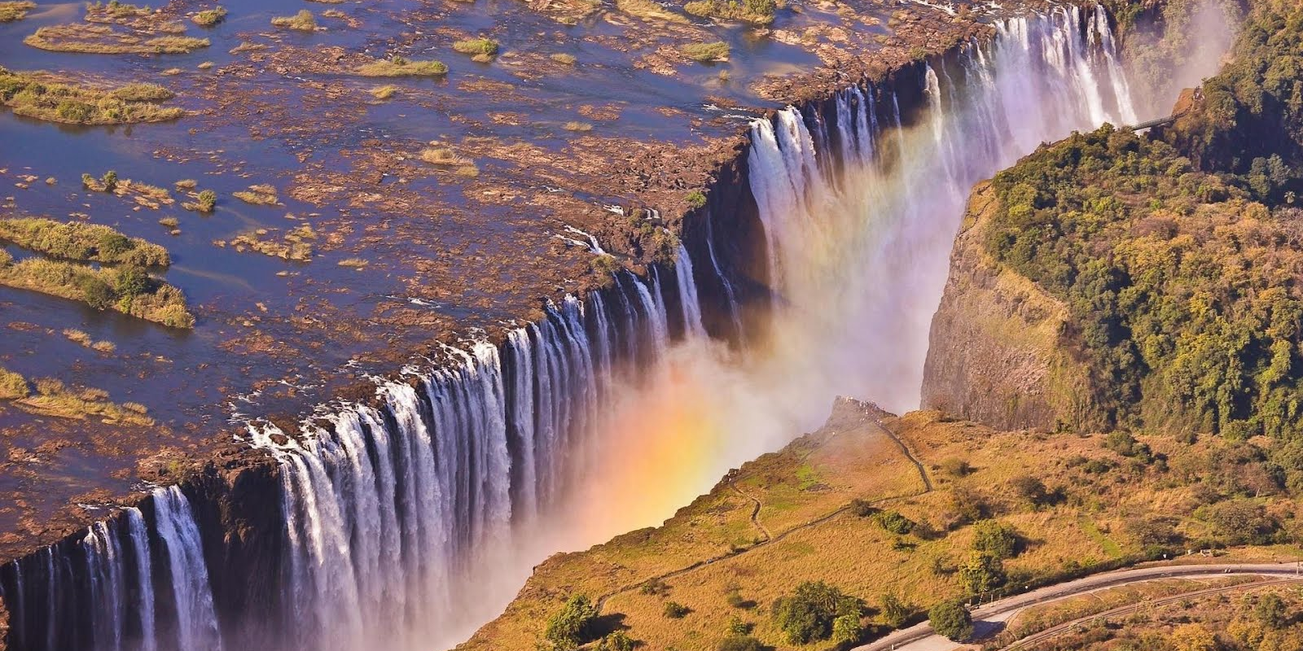
Where stunning waters flow…

Slide 7
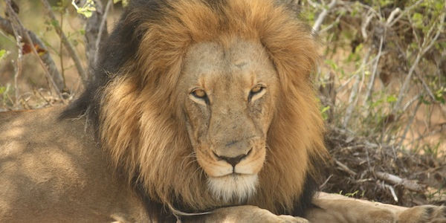
And lions live…

Slide 8
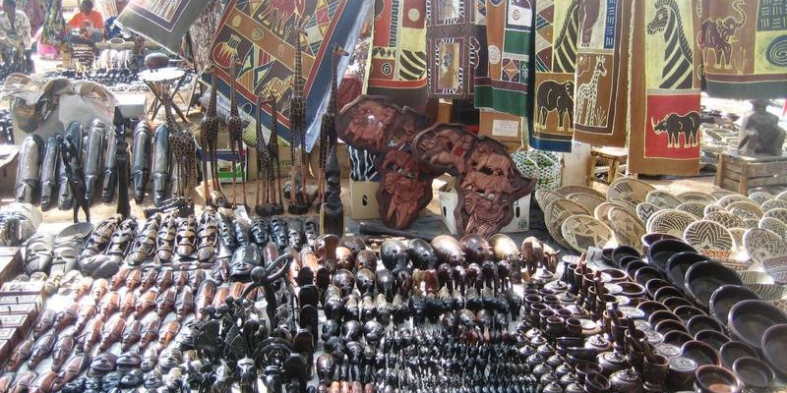
And markets thrive…

Slide 9
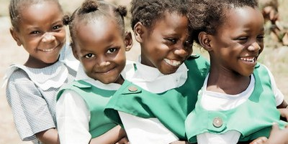
And children stand in rows…

Slide 10
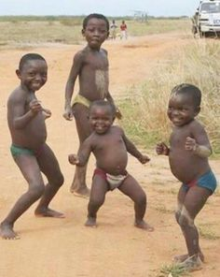
(And most times not!)

Slide 11
Brother Joe
…is off to Zambia

Slide 12
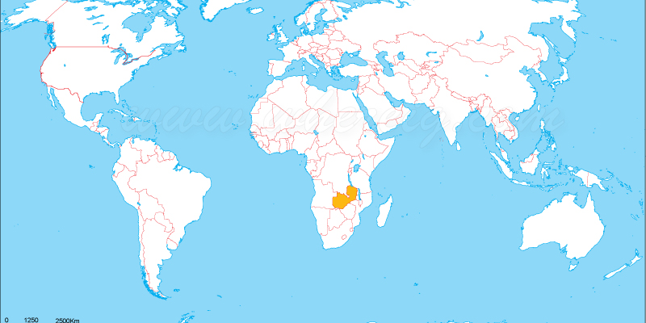
It feels so far away…

Slide 13
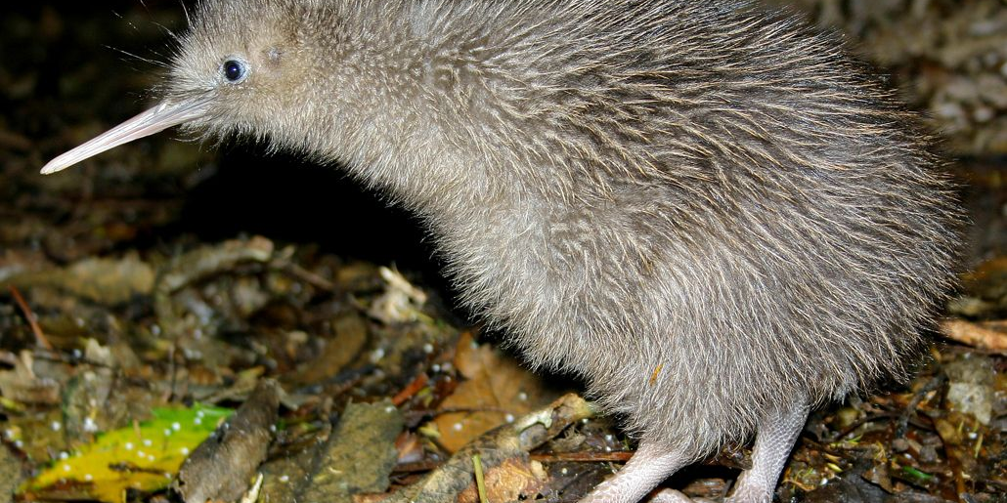
…I wondered if a Kiwi, could find a piece of home.
What comes up when you google Br Joe Lauren…

Slide 14
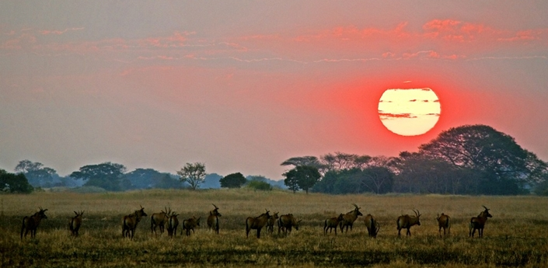
…so I went on a search…
What comes up when you google Br Joe Lauren…

Slide 15
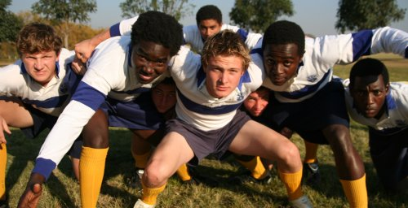
And found Rugby!

Slide 16
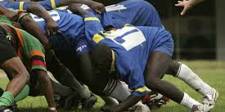
Oh Yeah!

Slide 17
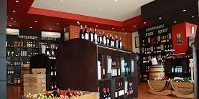
And red wine…
The wine shop in Lusaka!

Slide 18
And yeah… that was pretty much it…

Slide 19
So while Brother Joe
…is off in Zambia

Slide 20
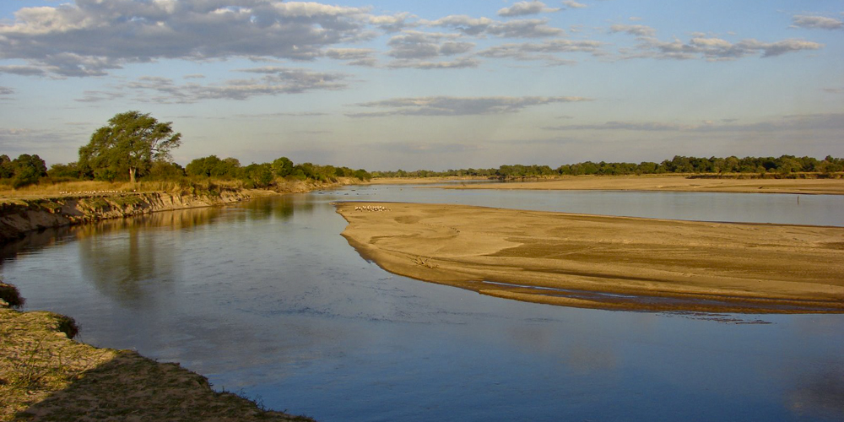
We wish him to fall in love…

Slide 21
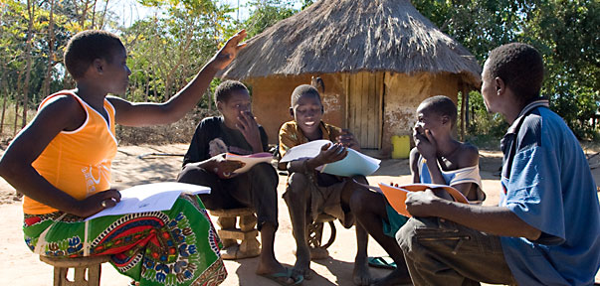
With a new people…

Slide 22
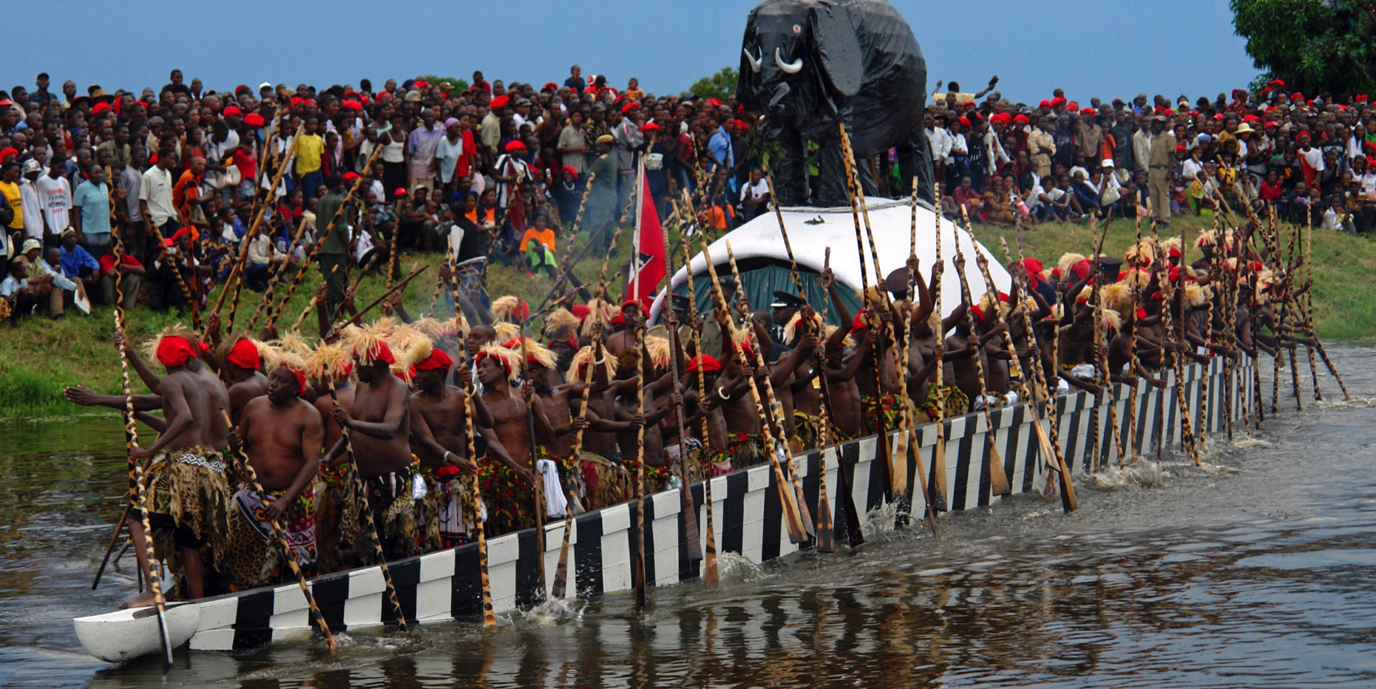
A new way…

Slide 23
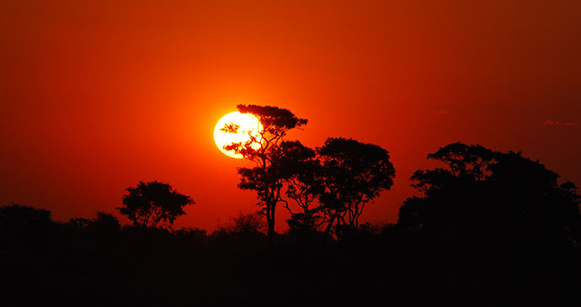
A new Sky and Land.

Slide 24
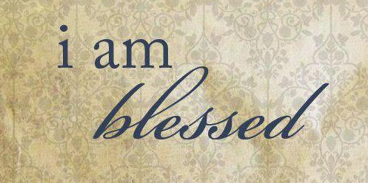
May he be blessed…

Slide 25
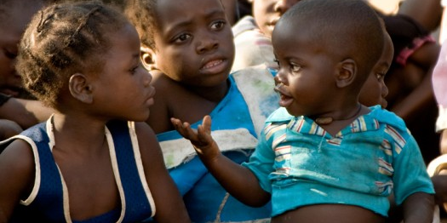
With new curiosity…

Slide 26
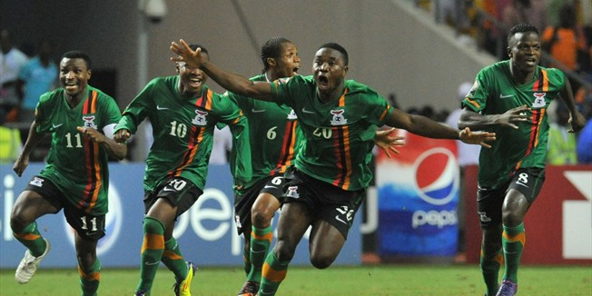
New joy…

Slide 27
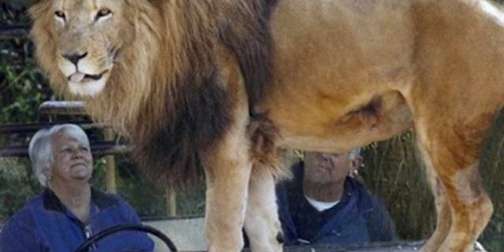
New peace…

Slide 28
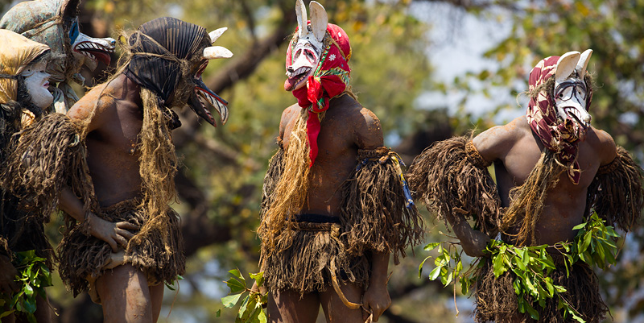
And new friends…

Slide 29
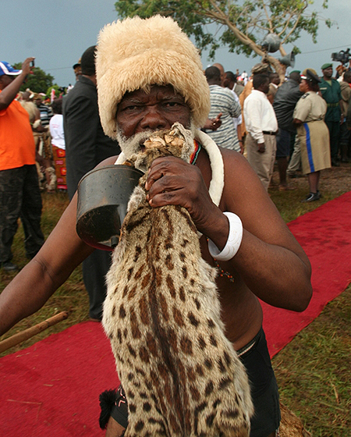
Hopefully he’ll find this guy too.

Slide 30
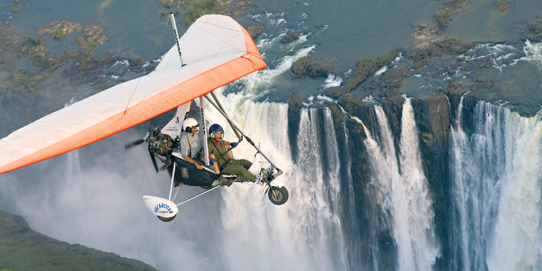
And most of all, that he’ll have fun… its an adventure after all!

Slide 31
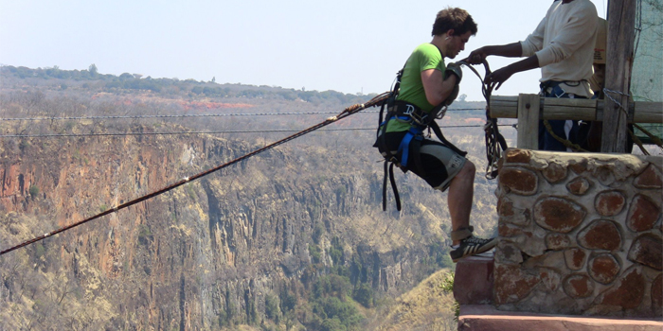
For through the risk of love and joy…

Slide 32
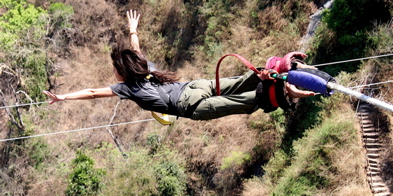
You’ll set yourself and others free!

Slide 33
“We are all meant to shine, as children do. We were born to make manifest the glory of God that is within us. It's not just in some of us; it's in everyone. And as we let our own light shine, we unconsciously give other people permission to do the same. As we are liberated from our own fear, our presence automatically liberates others.”
Marianne Williamson in ‘The Return to Love’

Slide 34
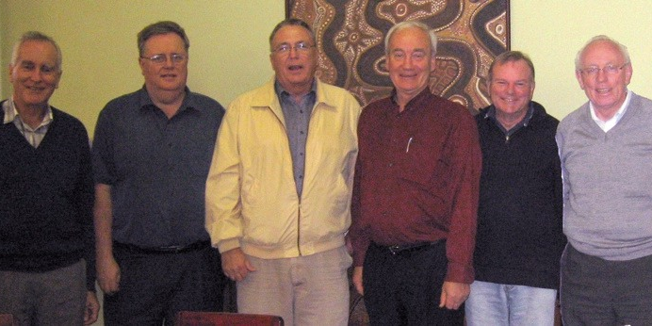
This fella!
What comes up when you google Br Joe Lauren…

Slide 35
Have an amazing time.
From all of us.

